Slide 1
Swift language
Function

Slide 2
Introduction to Functions
A program may perform the same operation repeatedly, causing a large and confusing program due to redundancy
Program redundancy can be reduced by creating a grouping of predefined statements for repeatedly used operations, known as a function
Even without redundancy, functions can prevent a main program from becoming large and confusing.

Slide 3
Introduction to Functions
A function is a block of code which only runs when it is called.
You can pass data, known as parameters, into a function
Function: group of statements within a program that perform as specific task
Usually one task of a large program
Functions can be executed in order to perform overall program task
Known as divide and conquer approach
Modularized program: program wherein each task within the program is in its own function

Slide 4
Function
A function is a set of statements that take inputs, do some specific computation and produces output
The idea is to put some commonly or repeatedly done task together and make a function, so that instead of writing the same code again and again for different inputs, we can call the function

Slide 5
Function
A function is a block of code which only runs when it is called
A program may perform the same operation repeatedly, causing a large and confusing program due to redundancy
Program redundancy can be reduced by creating a grouping of predefined statements for repeatedly used operations, known as a method
Even without redundancy, methods can prevent a main program from becoming large and confusing
You can pass data, known as parameters, into a function
A function can return data as a result

Slide 6
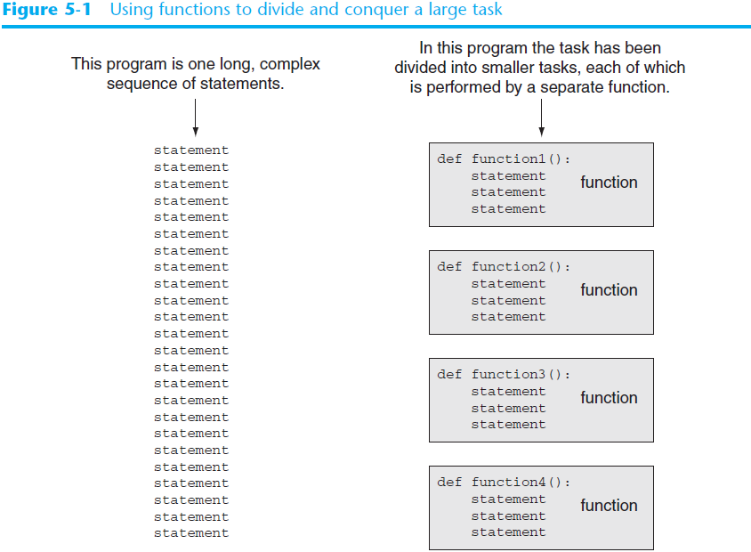

Slide 7
Defining and Calling a Function (cont’d.)
Function header: first line of function
Includes keyword def and function name, followed by parentheses and colon
Block: set of statements that belong together as a group
Example: the statements included in a function

Slide 8
Defining and Calling a Function
Call a function to execute it
When a function is called:
Interpreter jumps to the function and executes statements in the block
Interpreter jumps back to part of program that called the function
Known as function return

Slide 9
Void Functions and Value-Returning Functions
A void function:
Simply executes the statements it contains and then terminates.
A value-returning function:
Executes the statements it contains, and then it returns a value back to the statement that called it.
The input, int, and float functions are examples of value-returning functions.

Slide 10
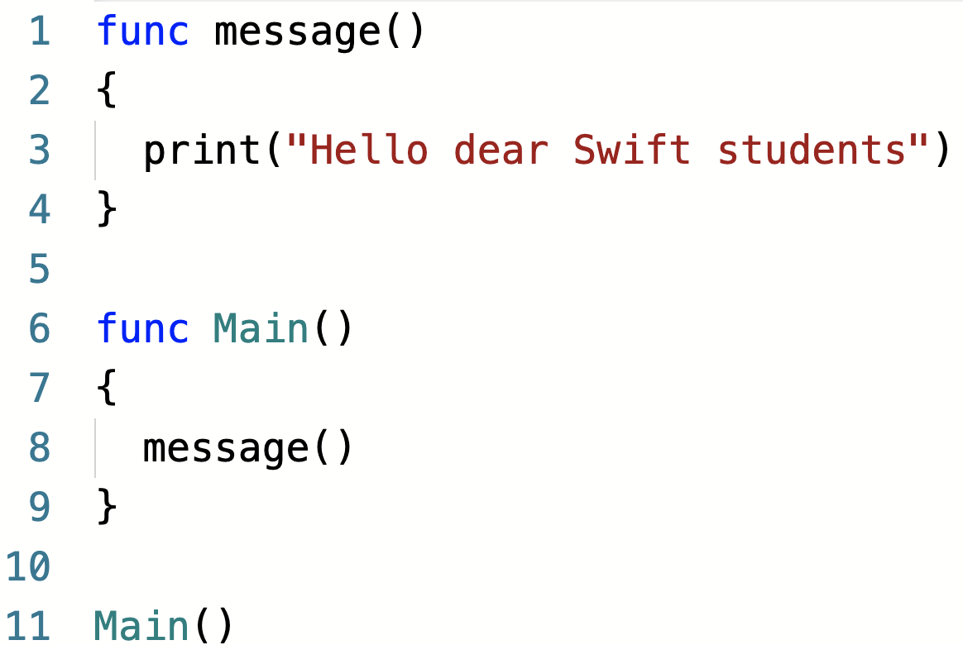
Sample function and function call

Slide 11
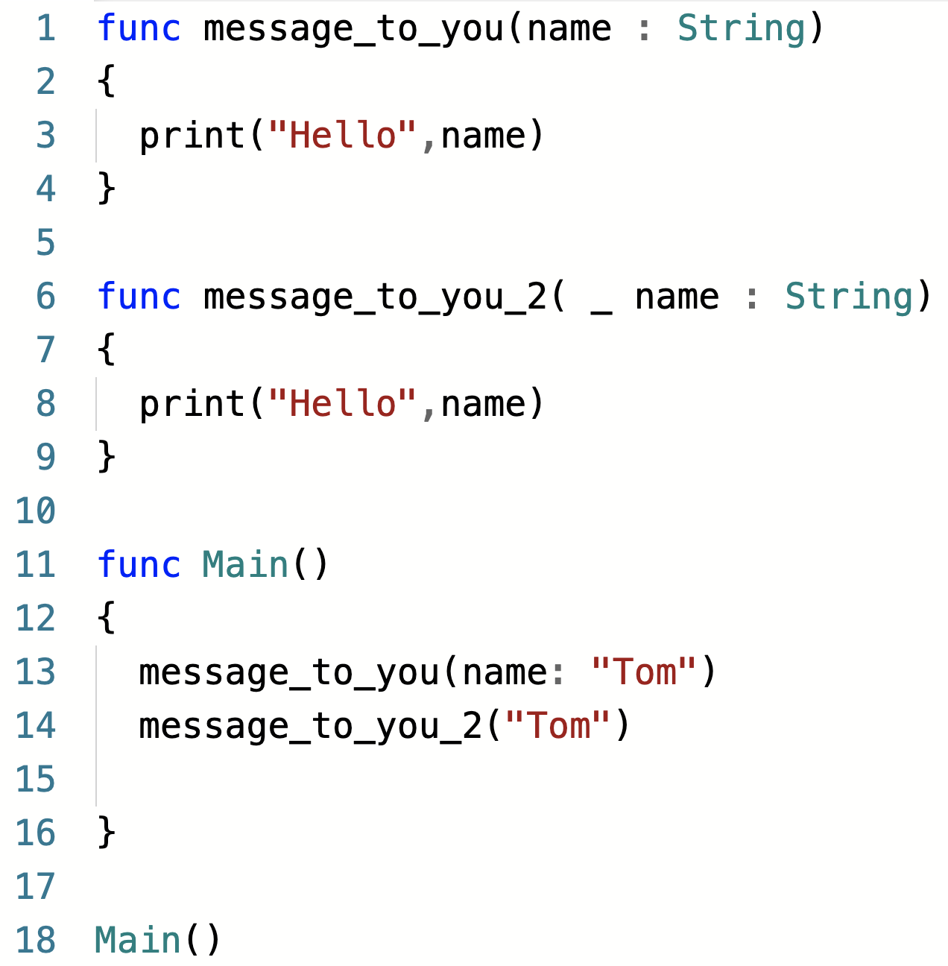
Sample function and function call

Slide 12
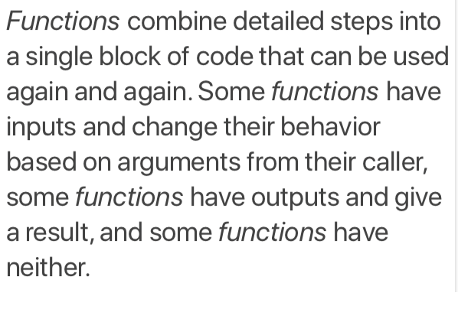
Function?

Slide 13
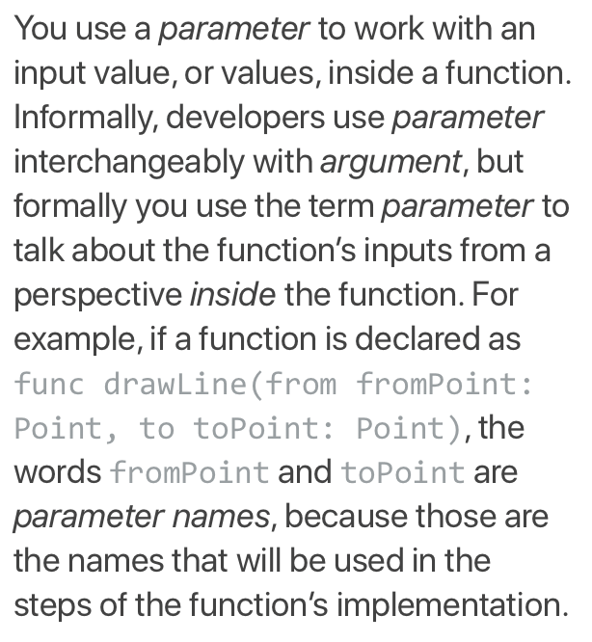
Parameter?

Slide 14
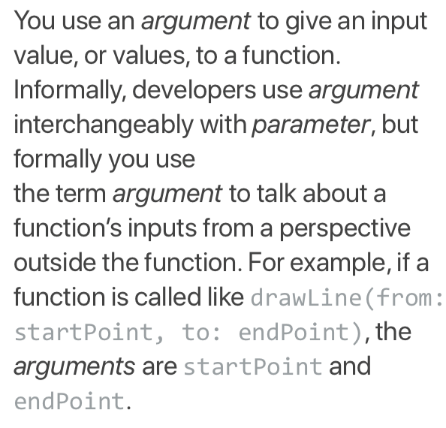
Argument?

Slide 15
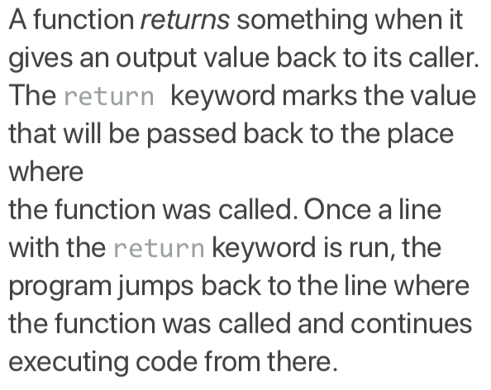
Return?

Slide 16
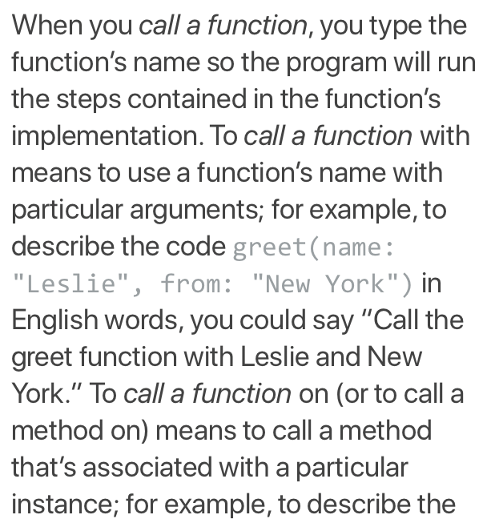
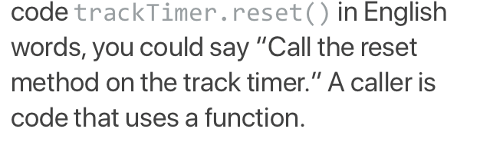
Call a Function?

Slide 17
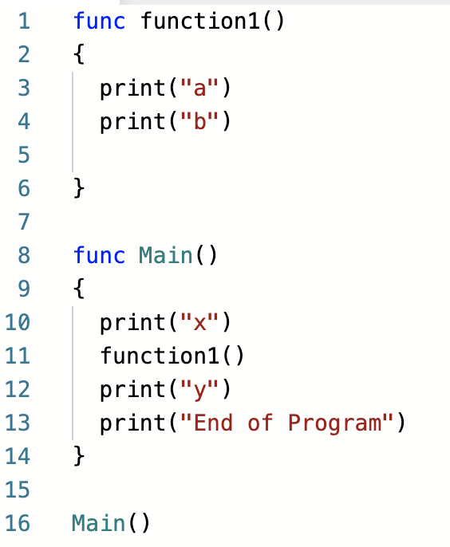
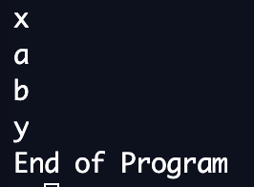
Call functions from main function

Slide 18
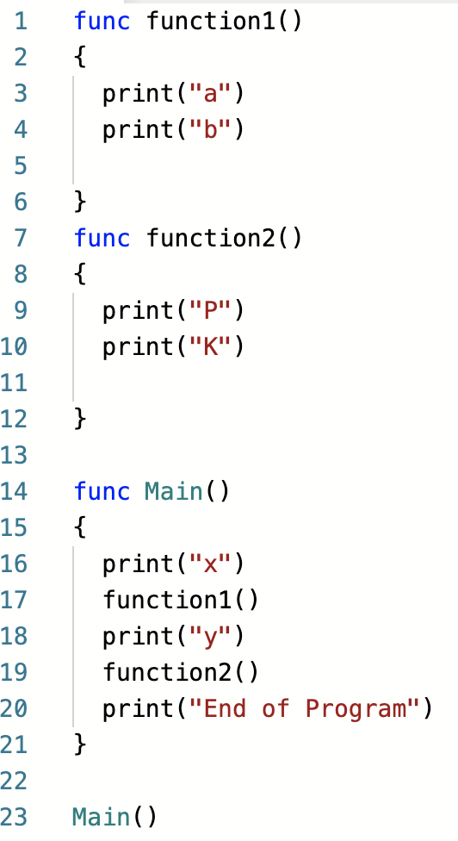
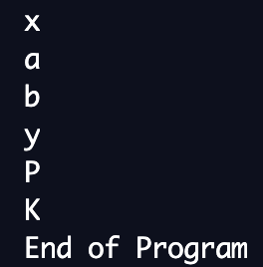
Call functions from main function

Slide 19
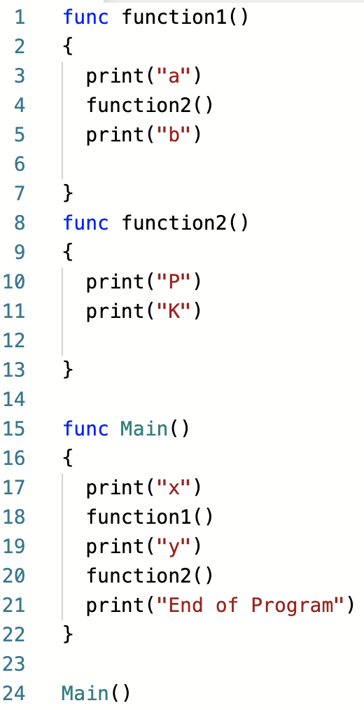
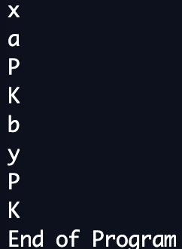
Can a Function call another function?

Slide 20
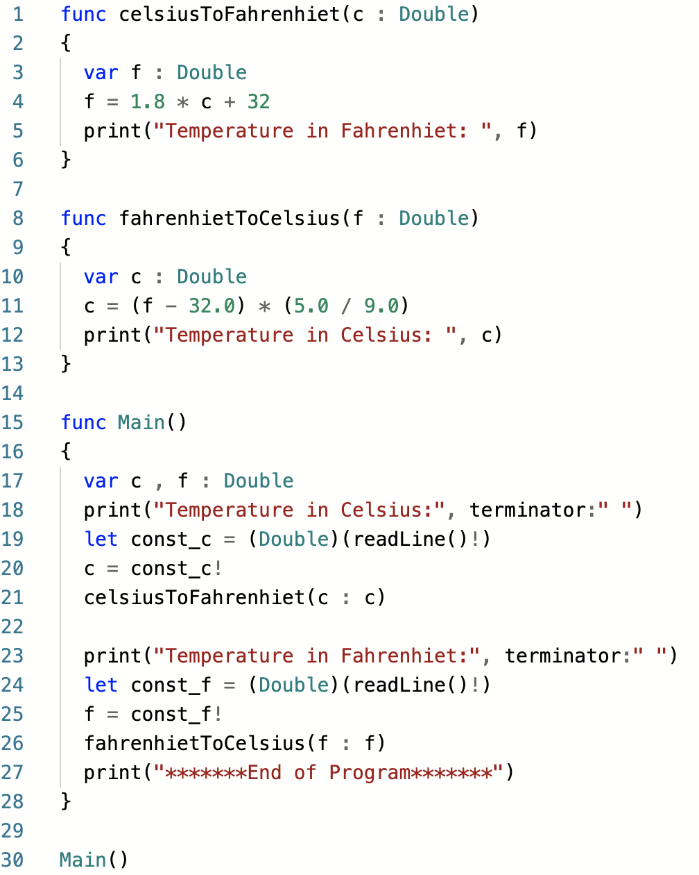
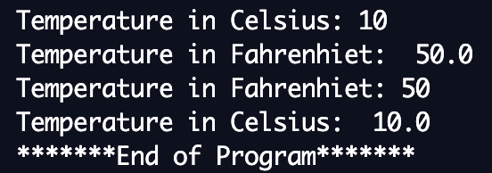
Can a Function call another function?

Slide 21
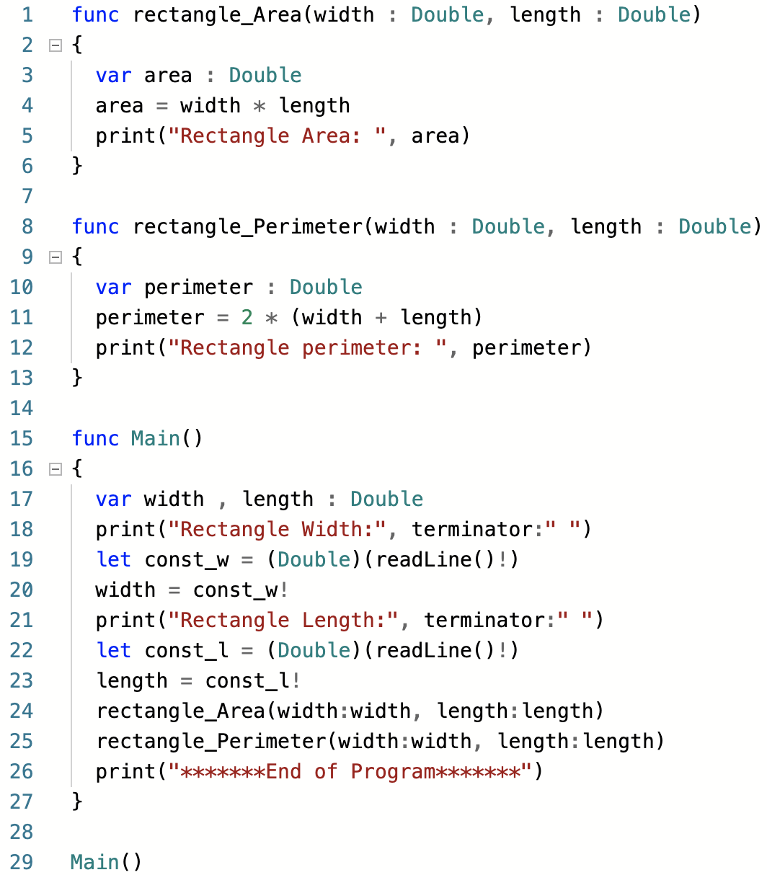
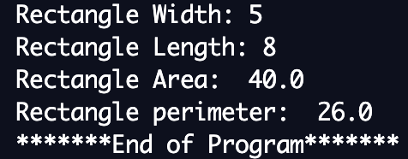
Can a Function call another function?

Slide 22
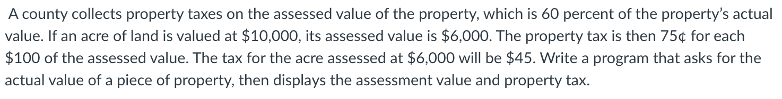
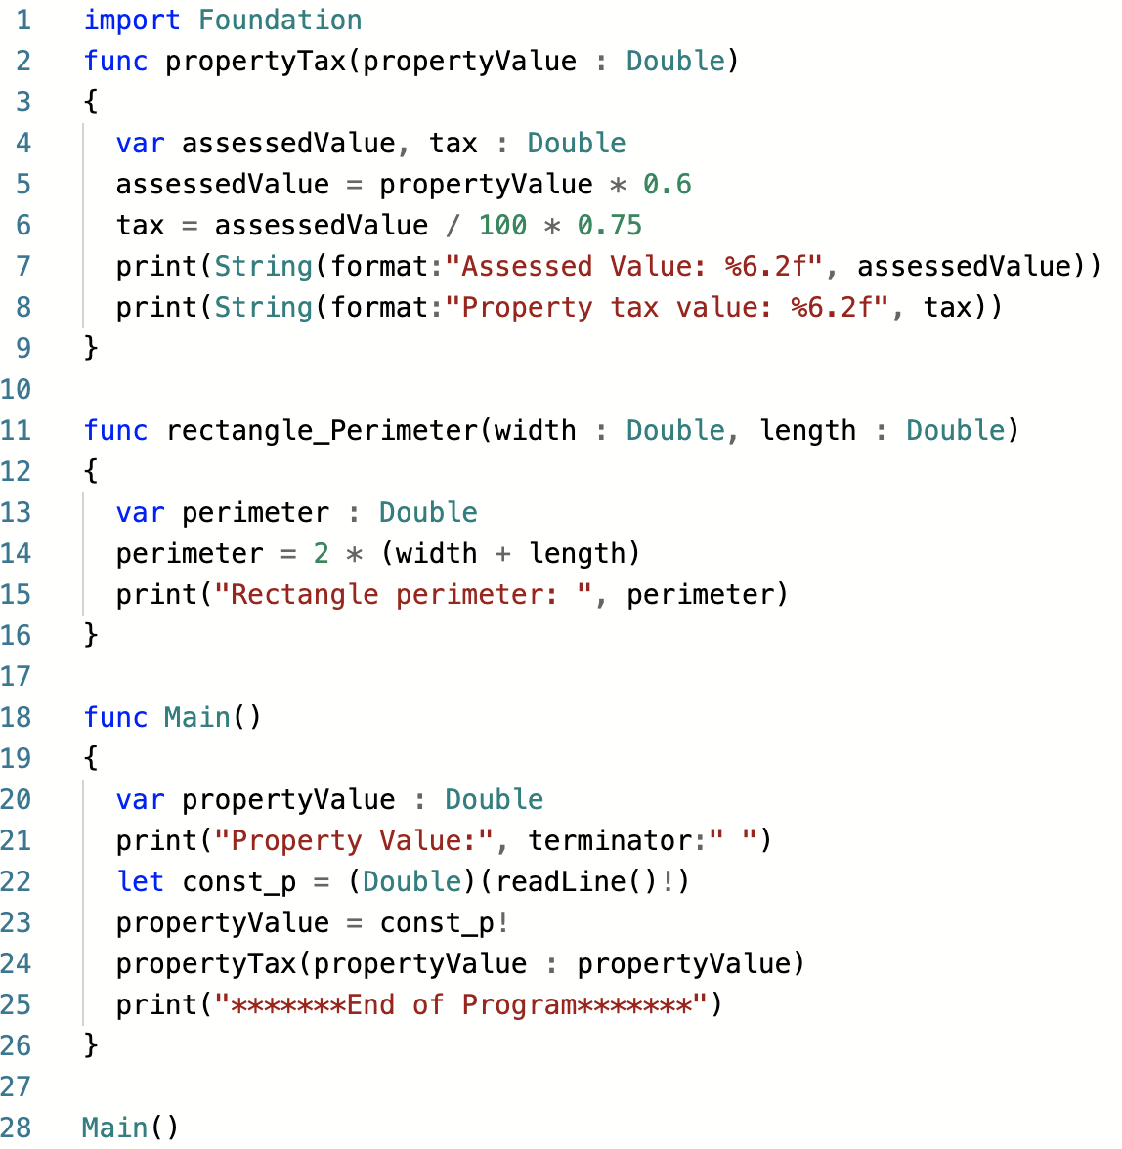
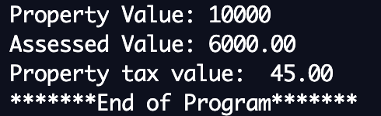

Slide 23
